Slide 1
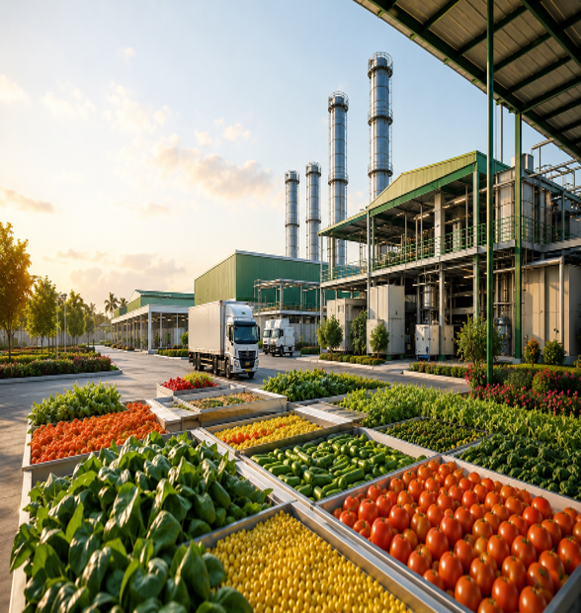

County Aggregation and Industrial Parks (CAIPs)

Slide 2
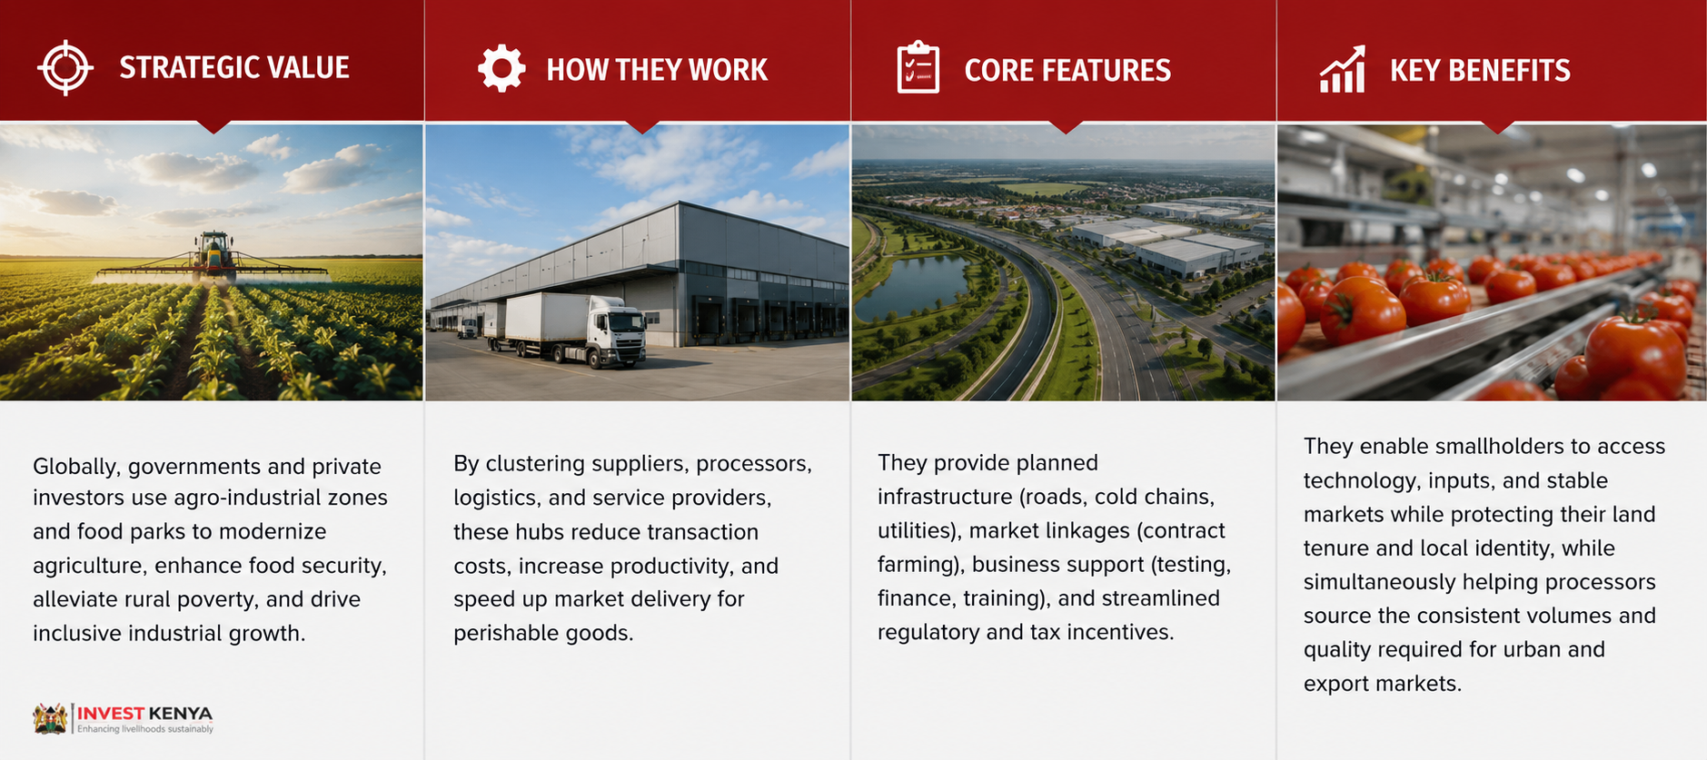
Overview

Slide 3
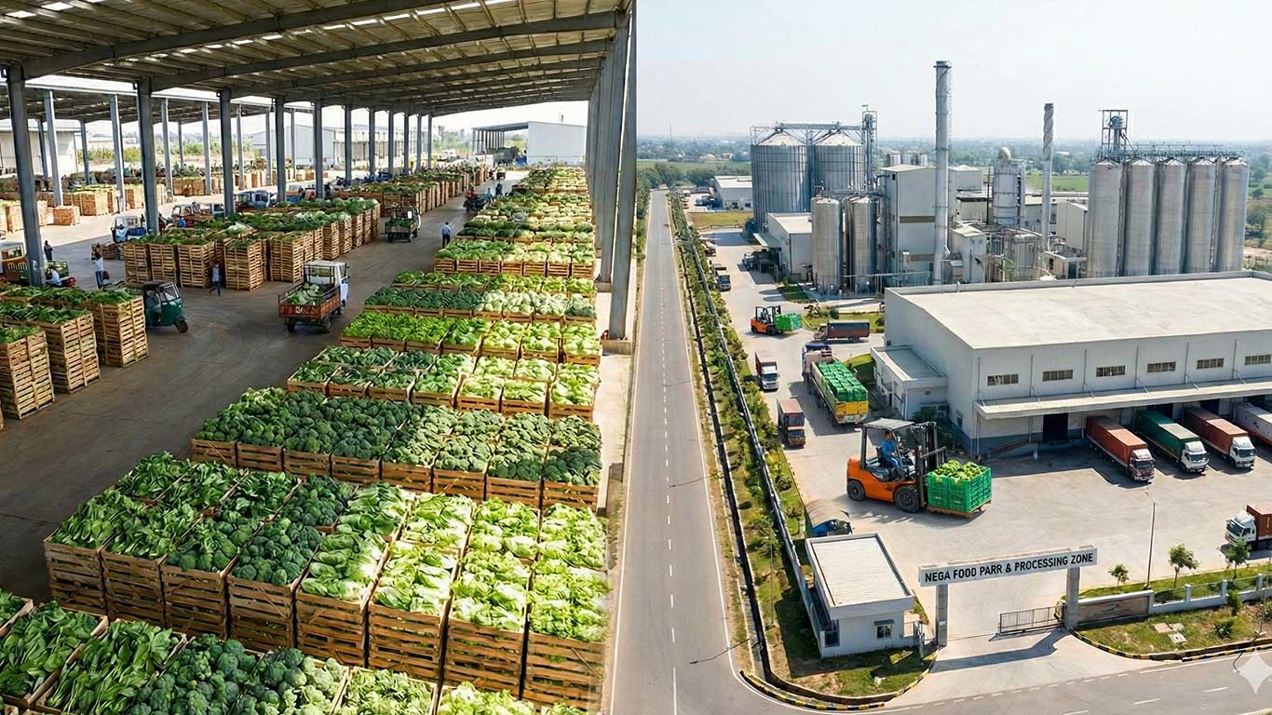
Lessons Across Borders
Country experiences illustrate the range of approaches and impacts:
  India created the Mega Food Parks program to aggregate primary processing, reduce post-harvest losses, and connect farmers to organized markets through centralized processing clusters and common facilities. The model prioritizes value addition and market-facing infrastructure to lift income along agricultural value chains.
  Malaysia and Vietnam have invested in agro-industrial corridors that spatially link production zones with processing facilities, port infrastructure, and export logistics, thereby fostering integrated supply chains that improve efficiency and competitiveness for exporters.
3

Slide 4
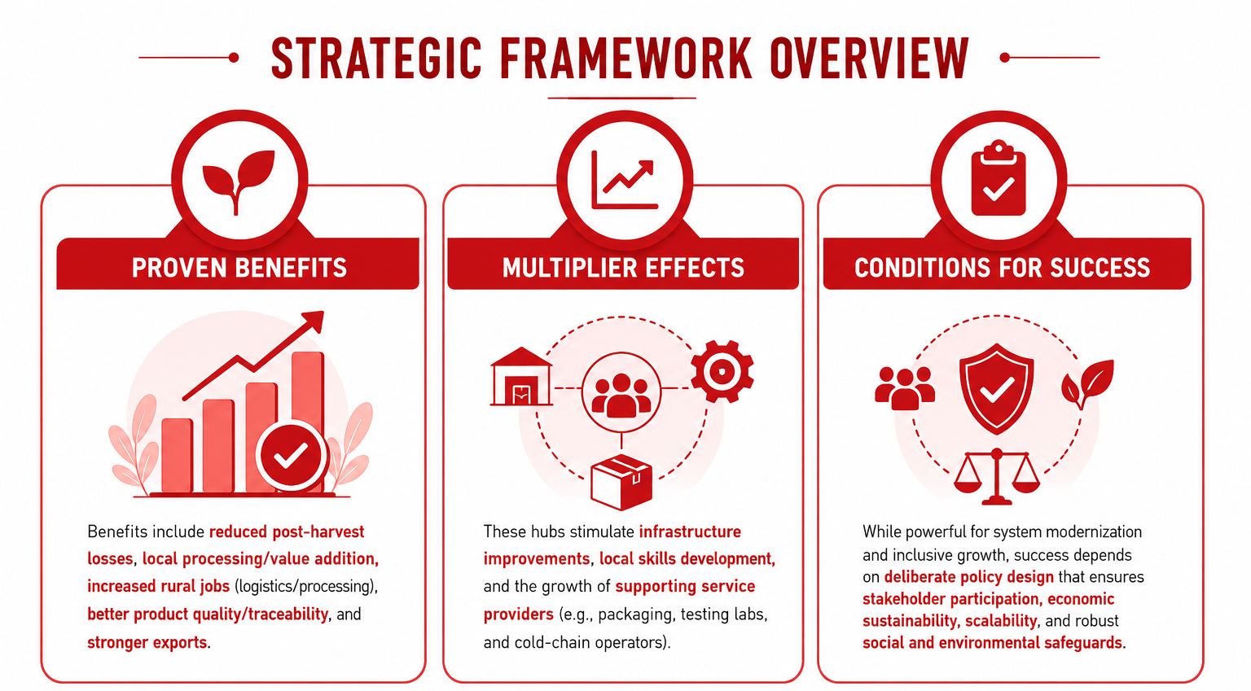
Overview (2/2)
4

Slide 5
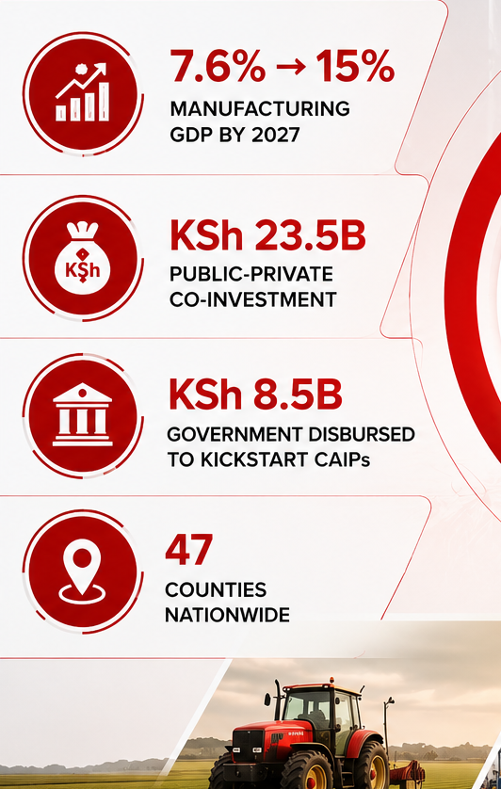

Background
Kenya is executing a fundamental shift in its economic architecture. Historically a consumer of finished imports and exporter of raw agricultural commodities, the country is rapidly moving up the value chain. Anchored under the Bottom-Up Economic Transformation Agenda (BETA), the Ministry of Investments, Trade and Industry (MITI)—in partnership with local governments—is rolling out County Aggregation and Industrial Parks (CAIPs) across all 47 counties.
This project aims to drive manufacturing from 7.6% to 15% of GDP by 2027. For institutional investors, private equity firms, and global anchor tenants, CAIPs offer a highly de-risked, heavily subsidized entry point into East Africa’s largest breadbasket
and manufacturing hub.
5

Slide 6
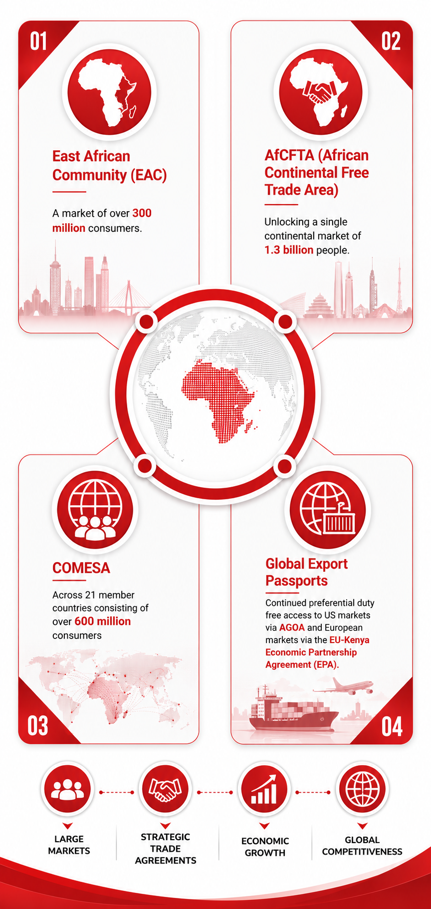
Macro investment opportunity
Kenya is uniquely positioned as the commercial and logistical gateway to East
and Central Africa.
Investing here provides frictionless access to several massive, integrated trade blocs:
East African Community (EAC)
A market of over 300 million consumers.
AfCFTA (African Continental Free Trade Area)
Unlocking a single continental market of 1.3 billion people.
COMESA
Across 21 member countries consisting of over 600 million consumers
Global Export Passports
Continued preferential duty-free access to US markets via AGOA and European markets via the EU-Kenya Economic Partnership Agreement (EPA).
  Infrastructure-Mombasa Port, SGR, roads, airports – operational
  Energy-87% green energy (geothermal, wind, solar) – reliable and cost-competitive
  Workforce-Young, Multilingual, tech savvy, entrepreneurial, growing annually
  Policy stability-Pro-business reforms, investment protection, profit repatriation
The Structural Gap: Despite producing world-class tea, coffee, avocados, horticulture, and livestock, Kenya loses 20% to 40% of its total yield annually to post-harvest losses due to poor cold-chain infrastructure and fragmented supply networks. CAIPs eliminate this bottleneck by co-locating aggregation directly with industrial-scale processing.
6

Slide 7
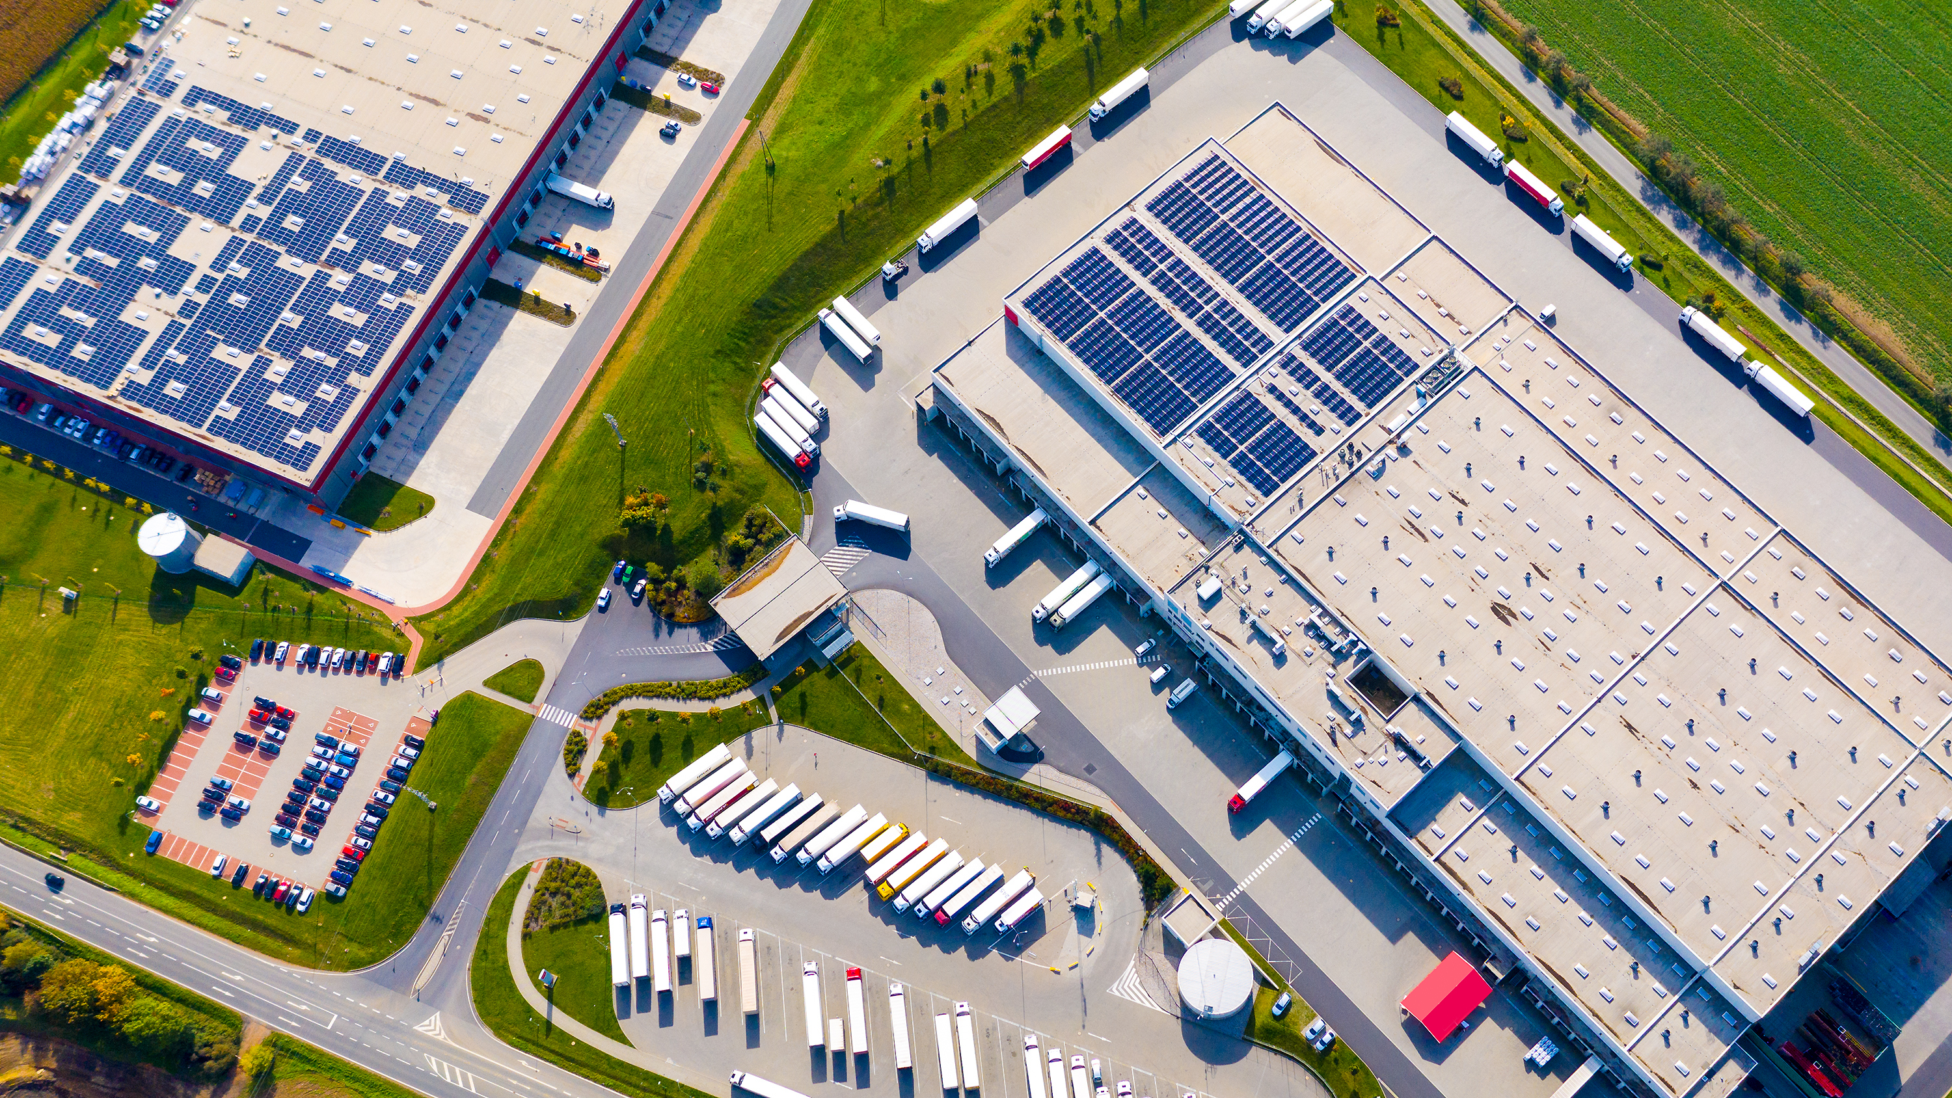
CAIPs architecture & design (1/2)
Each County Aggregation and Industrial Park is a custom-engineered, state-of-the-art facility constructed on a dedicated, public utility land.
The layout relies on a master-planned Hub-and-Spoke model that separates first-mile agricultural sorting from high-value manufacturing:
Local farms & cooperatives
(First Mile Logistics)
Aggregation Zone (The Spoke)
Cold Storage | Sorting/Labs
(Internal Transfer)
Industrial Park (The Hub)
Processing | Manufacturing
7

Slide 8
CAIPs architecture & design (2/2)
The Aggregation Zone (Spoke)
The Industrial Zone (Hub)
Primary Collection
Modern sorting, grading, and testing centers.
Ready-to-Use Warehouses
Industrial sheds optimized for processing plants.
Cold Chain Infrastructure
Multi-chamber cold-storage warehouses powered by subsidized renewable energy grids to neutralize post-harvest decay.
Build-to-Suit Plots
Open, serviced industrial plots complete with high-voltage 3-phase power, high-volume water hookups, and high-speed fiber connectivity.
Common User Facilities
Shared logistics docks, weighbridges, and container yards to compress handling costs.
Effluent Treatment
Centralized, eco-friendly industrial wastewater treatment plants to ensure seamless environmental compliance.
Quarantine and quality assurance
Innovation and incubation centers.

Slide 9
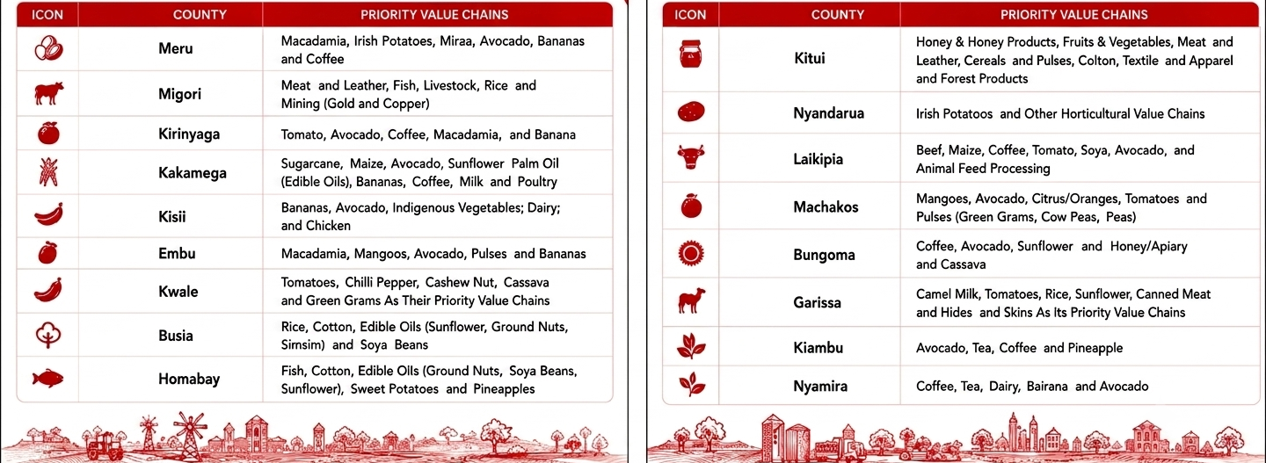
Targeted value chains (1/2)
The CAIP roll-out does not take a one-size-fits-all approach. Each park is strictly optimized around the specific ecological and agricultural competitive advantages of its host county:
No.
County
Investment - Priority Value Chains
No. | County | Investment Priority Value Chains
1 | Meru | Macadamia, Irish Potatoes, Miraa, Avocado, Bananas and Coffee
2 | Migori | Meat and Leather, Fish, Livestock, Rice and Mining (Gold and Copper)
3 | Kirinyaga | Tomato, Avocado, Coffee, Macadamia, and Banana
4 | Kakamega | Sugarcane, Maize, Avocado, Sunflower Palm Oil (Edible Oils), Bananas, Coffee, Milk and Poultry
5 | Kisii | Bananas; Avocado; Indigenous Vegetables; Dairy; and Chicken

Slide 10
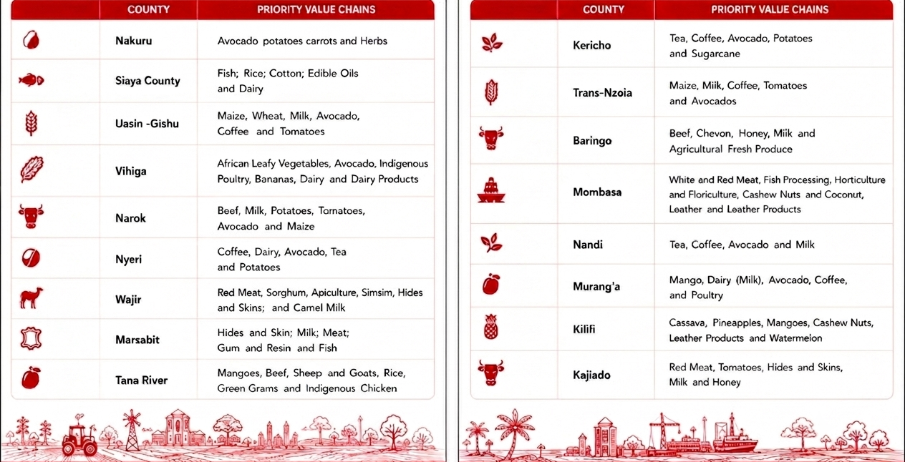
Targeted value chains (2/2)
The CAIP roll-out does not take a one-size-fits-all approach. Each park is strictly optimized around the specific ecological and agricultural competitive advantages of its host county:
No.
County
Investment - Priority Value Chains
No. | County | Investment Priority Value Chains
1 | Meru | Macadamia, Irish Potatoes, Miraa, Avocado, Bananas and Coffee
2 | Migori | Meat and Leather, Fish, Livestock, Rice and Mining (Gold and Copper)
3 | Kirinyaga | Tomato, Avocado, Coffee, Macadamia, and Banana
4 | Kakamega | Sugarcane, Maize, Avocado, Sunflower Palm Oil (Edible Oils), Bananas, Coffee, Milk and Poultry
5 | Kisii | Bananas; Avocado; Indigenous Vegetables; Dairy; and Chicken

Slide 11
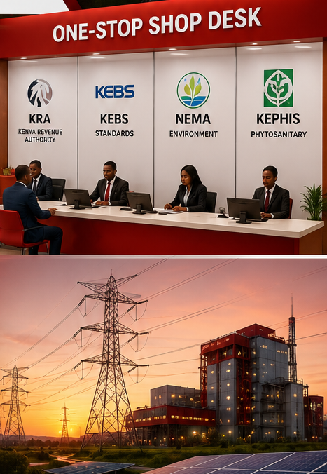
Strategic fiscal & regulatory incentives
To maximize internal rates of return (IRR) for private partners, the Government of Kenya has packaged CAIPs with an aggressive suite of fiscal incentives and regulatory carve-outs:
Tax Holidays & Exemptions
Dedicated corporate tax discounts, duty-free importation of all capital machinery, equipment, and raw materials, and statutory exemptions on Value Added Tax (VAT).
The "One-Stop Shop" Desk
On-site, fast-tracked regulatory clearance hubs housing officers from the Kenya Revenue Authority (KRA), KEBS (Standards), NEMA (Environment), and KEPHIS (Phytosanitary). This cuts red tape and slashes setup times from months to days.
Subsidized Utilities
Artificially cushioned lease structures on public land paired with preferential industrial power tariffs from Kenya’s 90%+
green energy grid.
11

Slide 12
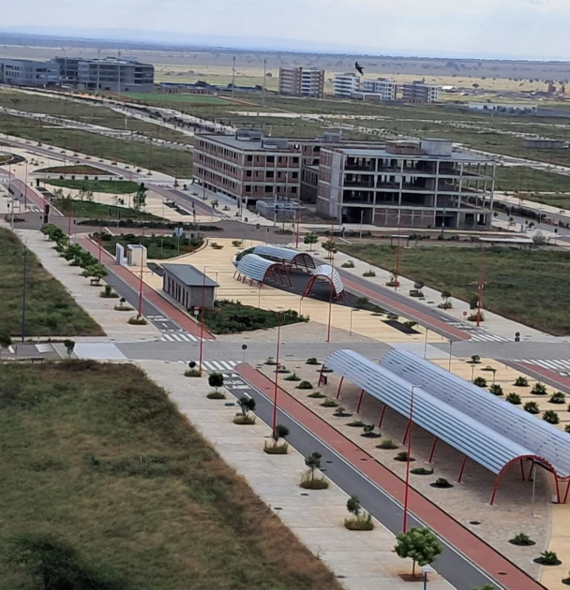
Operational models
Economic Zones (SEZs) / Park Developers
Private operators can sign long-term master concessions to develop, manage, and lease out specialized segments of the parks. You build and operate the common user infrastructure (like specialized cold storage or water processing) and collect steady yield-backed revenues from tenants.
12

Slide 13
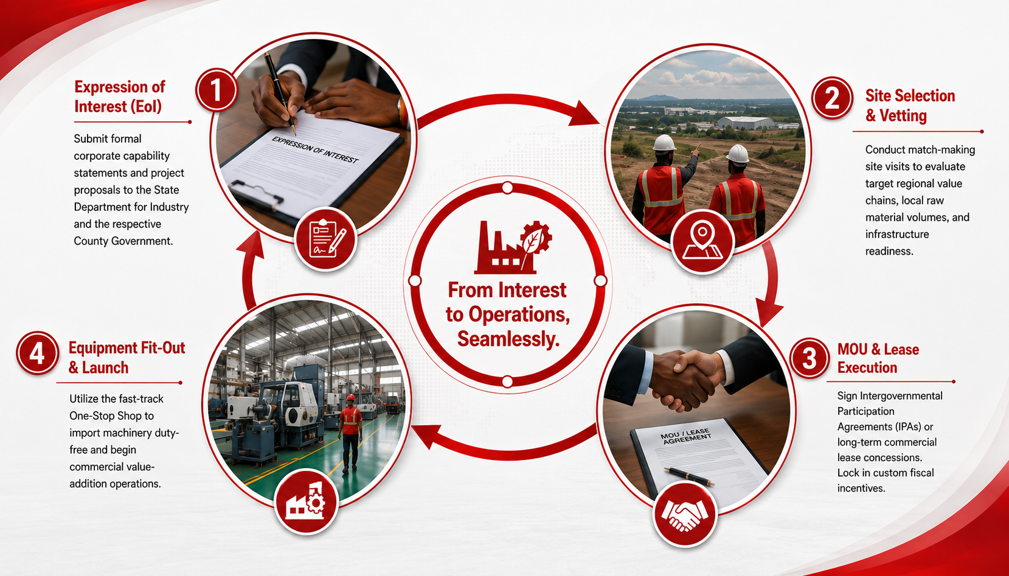
Anchor Manufacturers & Processors

Slide 14
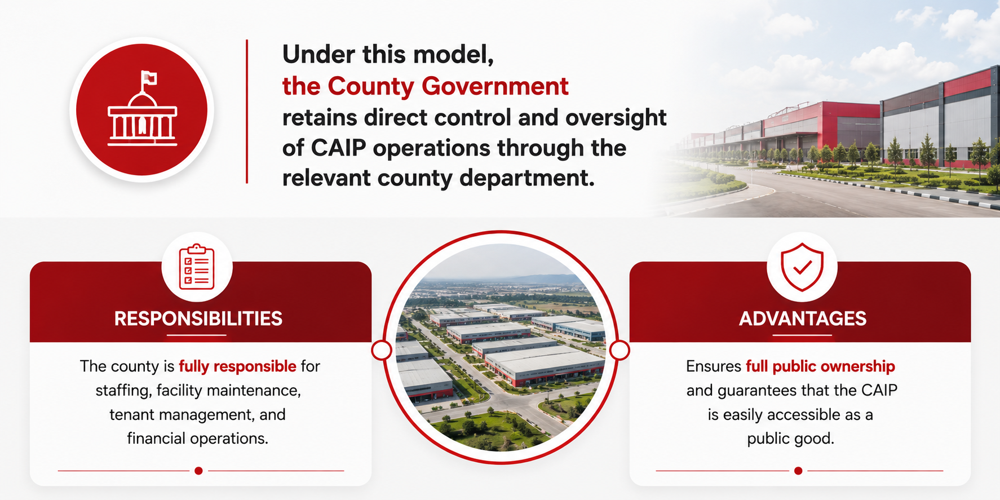
County Government Operated Model
Responsibilities
Advantages

Slide 15
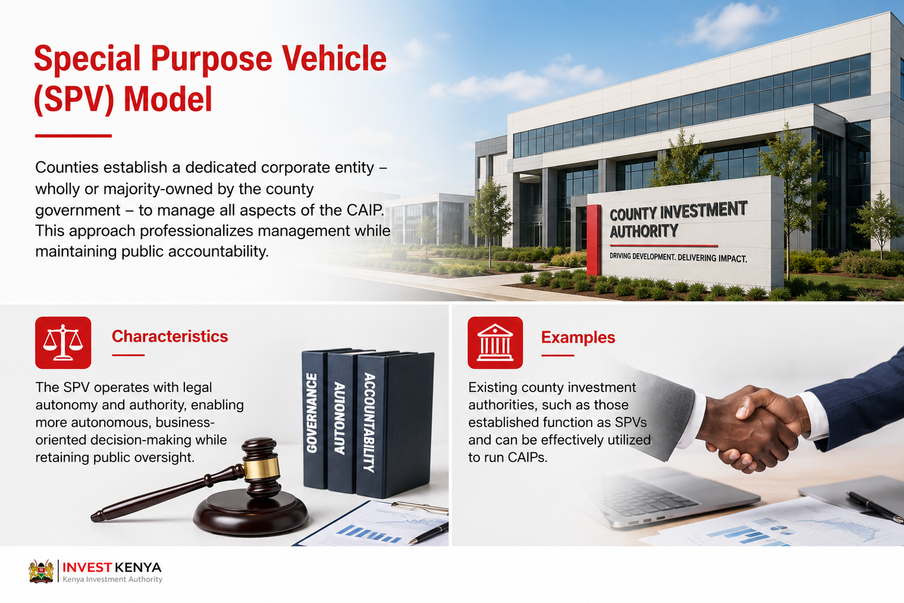
Special Purpose Vehicle (SPV) Model
Counties establish a dedicated corporate entity – wholly or majority-owned by the county government – to manage all aspects of the CAIP. This approach professionalizes management while maintaining public accountability.
Characteristics
Examples
The SPV operates with legal autonomy and authority, enabling more autonomous, business-oriented decision-making while retaining public oversight.
Existing county investment authorities, such as those established function as SPVs and can be effectively utilized to run CAIPs.
15

Slide 16
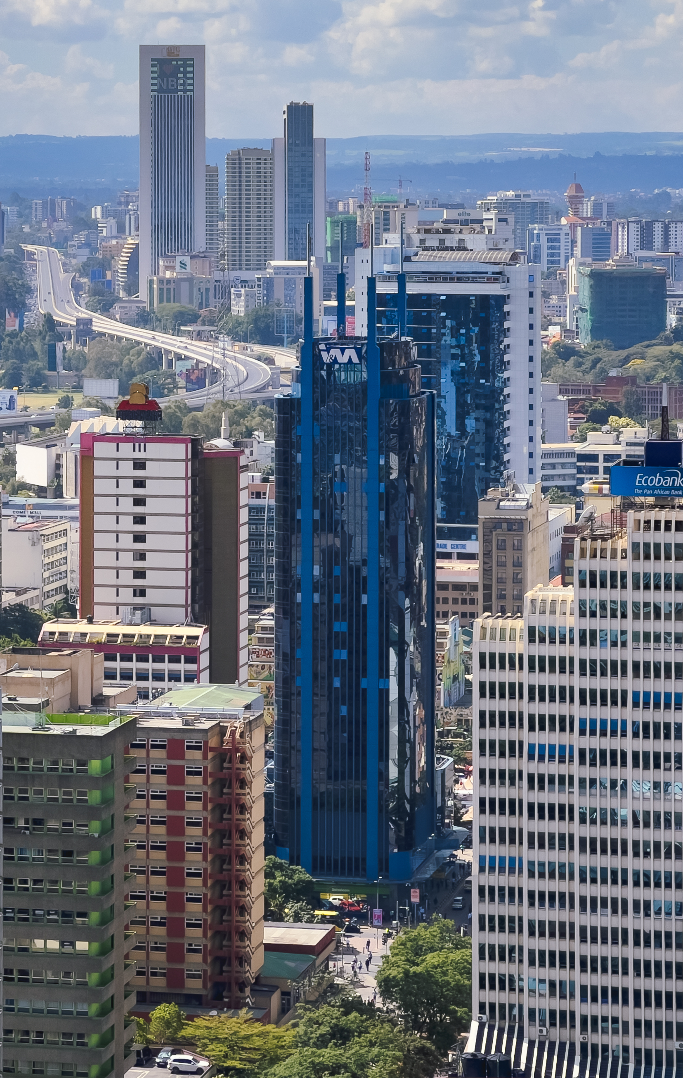
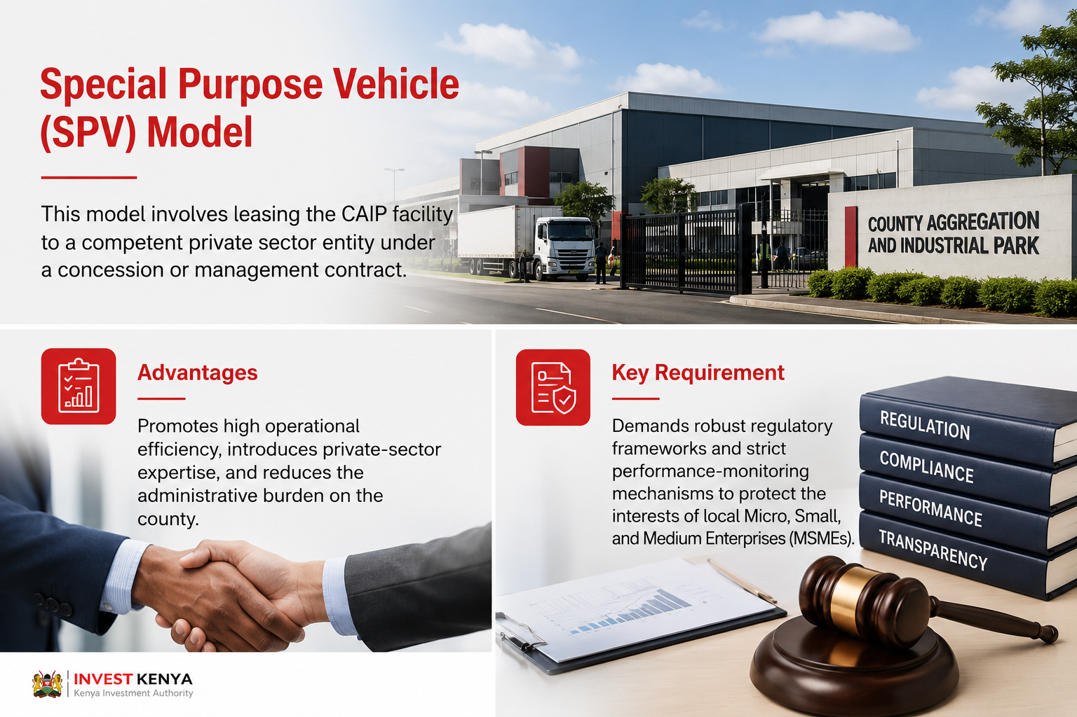
Special Purpose Vehicle (SPV) Model
This model involves leasing the CAIP facility to a competent private sector entity under a concession or management contract.
Advantages
Key Requirement
Promotes high operational efficiency, introduces private-sector expertise, and reduces the administrative burden on the county.
Demands robust regulatory frameworks and strict performance-monitoring mechanisms to protect the interests of local Micro, Small, and Medium Enterprises (MSMEs).
16

